Slide 1
Planogram Updater
Quiz 1 Challenge
Joel Vinas

Slide 2
Scenario description
Retailers like CVS and Walgreens use planograms to explain design displays to their merchandising staff.
Static planograms directed by HQ are unable to adapt to local inventory shortages.
Goal: Build a data-driven system to generate realistic pharmacy shelf layouts based on SKU metadata.

Slide 3
Dataset
Primary Data: We generated a custom 'pharmacy_stock_items.csv’
6-digit SKU
Product Name
Cost
Price
Margin
Visual dimensions (height, width)
Velocity (high-sales items)
Anchor Template: Generated by Google Gemini, this was a 7-shelf backdrop with preset shelf_bounds to manage precise placement
SKU Imagery: Stable Diffusion generates images for each SKU based on the Product Name

Slide 4
Methodology
Environment Engine: Stable Diffusion generates a realistic, empty background from a template.
Data Orchestrator: Python logic reads CSV metadata to determine SKU placement coordinates.
SVG Framework: Generates an SVG file using <image> tags to layer SKU assets onto the SD background.
Deterministic Control: Prevents AI 'hallucinations' by using vector coordinates for merchandise.

Slide 5
Stable Diffusion pipeline
Framework: Hugging Face Diffusers (Stable Diffusion v1.5)
Model: 'runwayml/stable-diffusion-inpainting' for background enhancement
Scheduler: UniPCMultistepScheduler for optimized 30-step inference
Hardware: CUDA-enabled GPU for half-precision (float16) processing
Although GPU was enabled, most work was done via CPU due to hardware

Slide 6
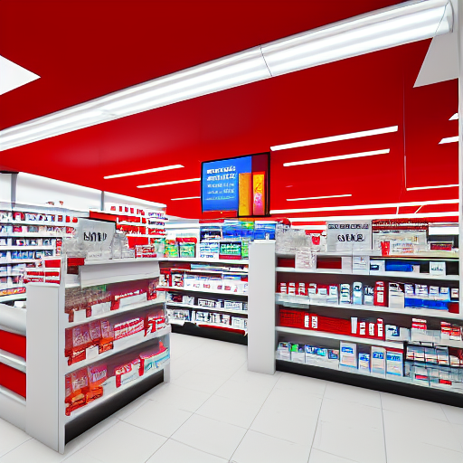
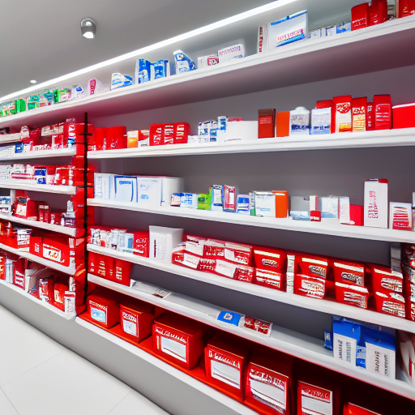
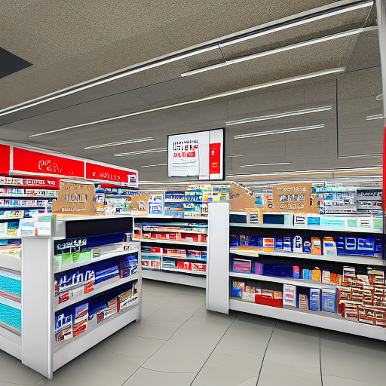
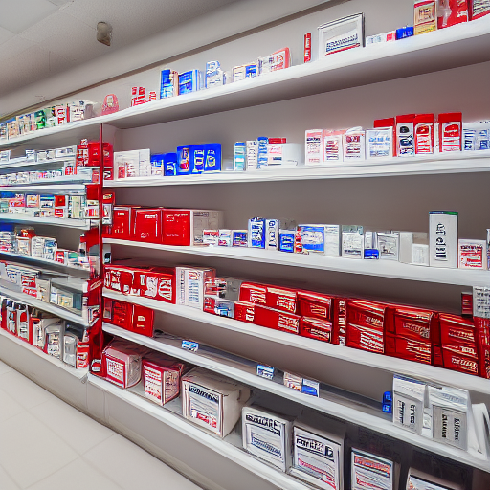
Prompt Design & Results
Initial Prompt
Revised Prompt
Inconsistent Store Brand
Clearer shelves
More Consistent Branding
Weak control of stock

Slide 7
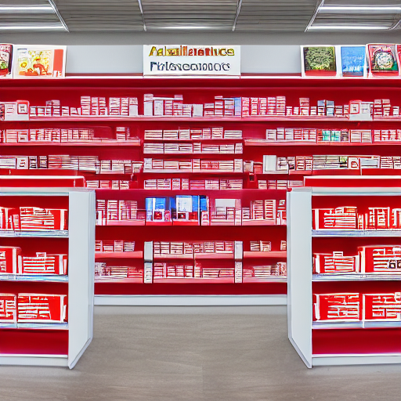
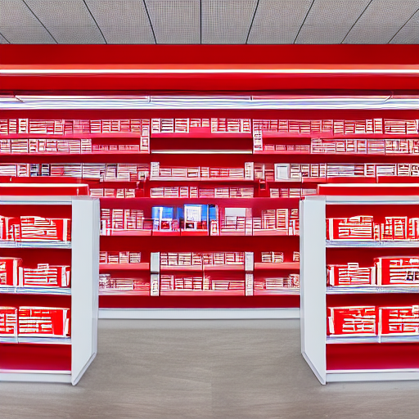
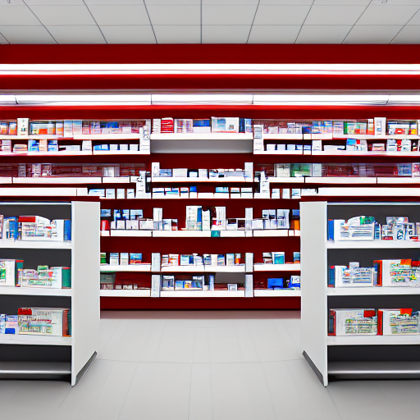
Prompt Design & Results (Round #3)
Re-running resulted in an entirely new store layout
This inconsistency meant a complete lack of control – driven by Stable Diffusion
I attempted to stabilize this by using the existing layout as an anchored template

Slide 8
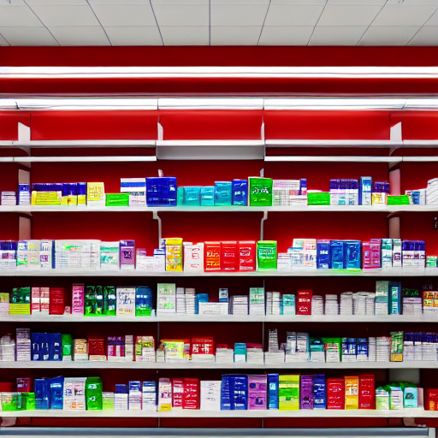
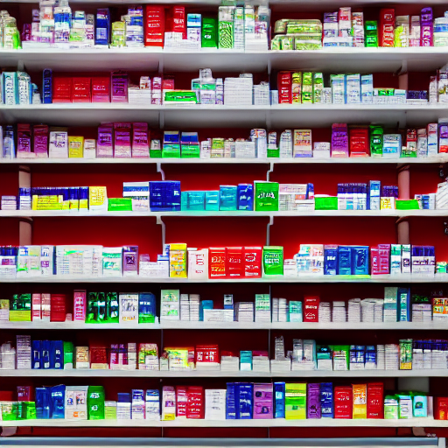
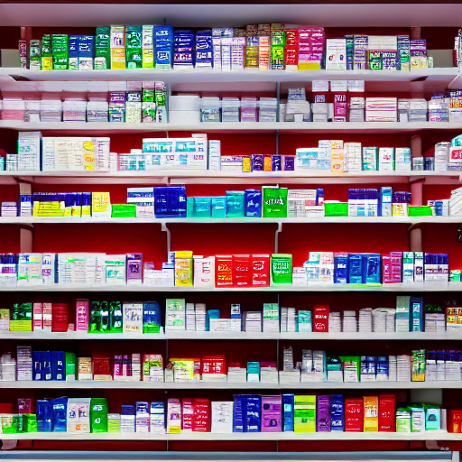
Prompt Design & Results (Round #4)
I defined a fixed wall with 7-shelves at 58” in height
I then had Stable Diffusion fill the shelves
The result was exceptional – but had merchandise stacked to the ceiling

Slide 9
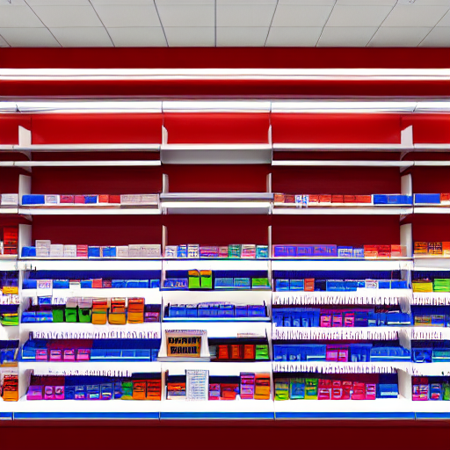
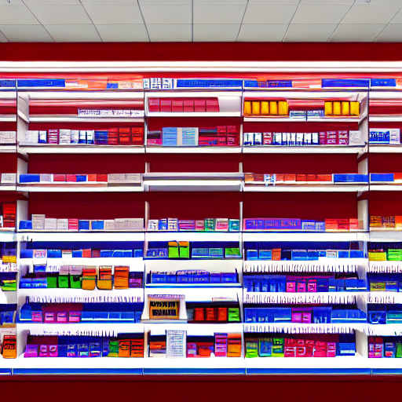
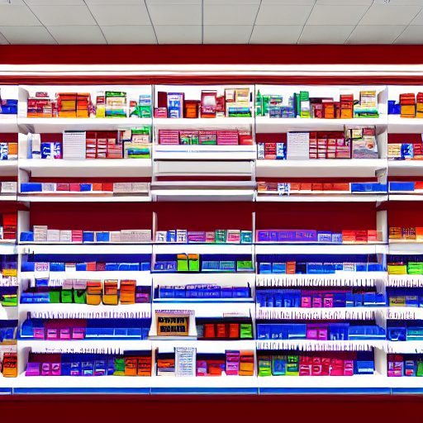
Prompt Design & Results (Round #5)
I defined a blank template (using Google Gemini)
This template was then modified to an intermediate template where all but one shelf was changed
The intermediate template was updated twice:
Base Result
Updated result
Although this looked excellent, it was useless from a business perspective as I couldn’t control SKUs

Slide 10
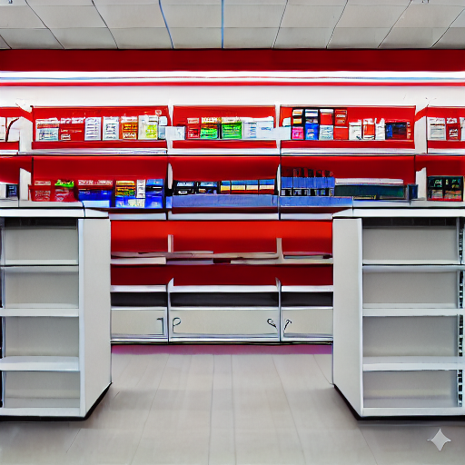
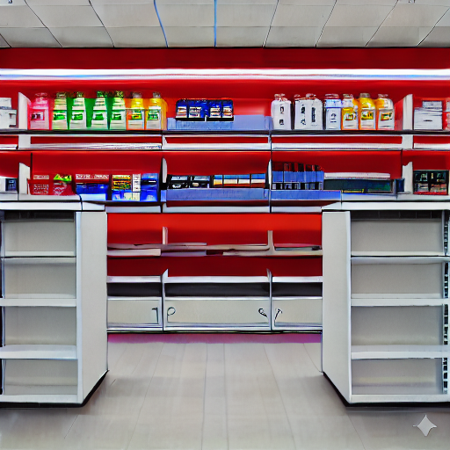
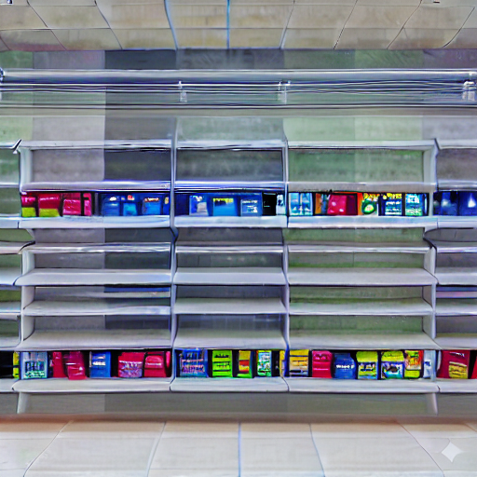
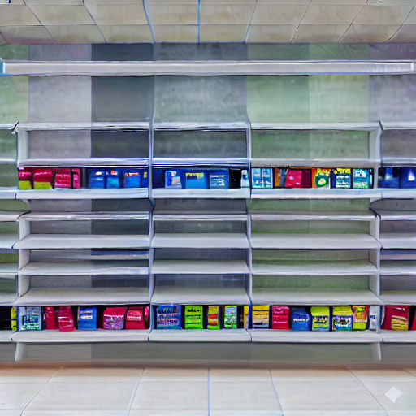
Prompt Design & Results (Round #6 & #7)
Round #6: Rerunning the code resulted in undesired results including shelf lines and short shelves blocking the view
Round #7: Unable to properly remove the short shelves I started with a new template design entirely. I was still unable to control SKU placement

Slide 11
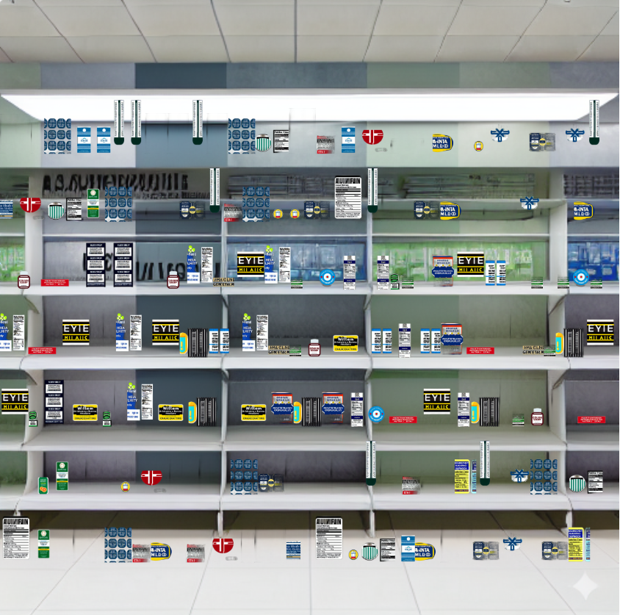
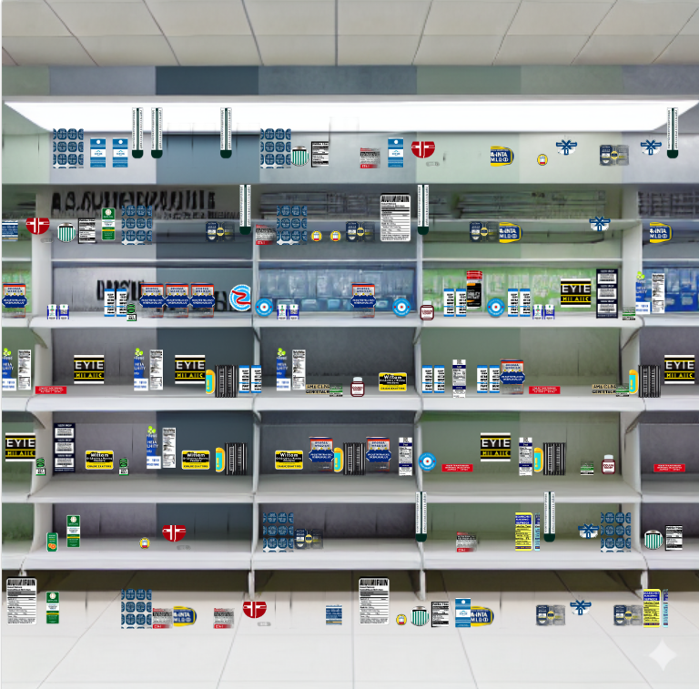
Prompt Design & Results (Round #8+)
I spent multiple rounds to determine how to create unique SKU imagery for each SKU, working to get usable 2-D images.
After all SKU images were generated, I had the system place these against the blank backdrop
Future iterations worked to space the shelves more cleanly moving from 7 shelves to 6 working shelves

Slide 12
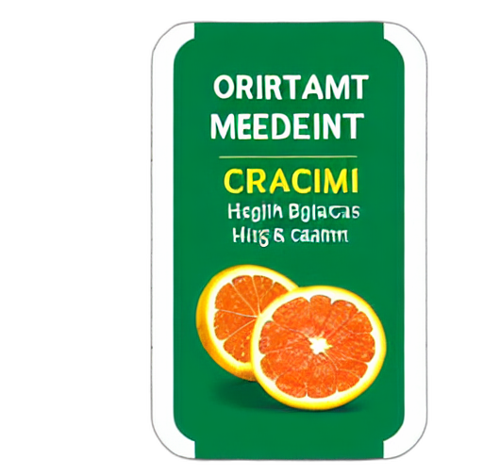
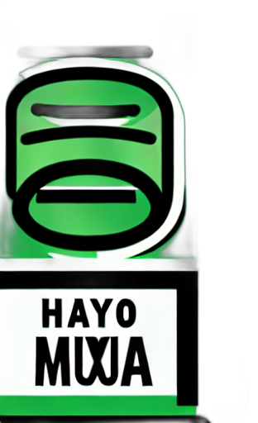

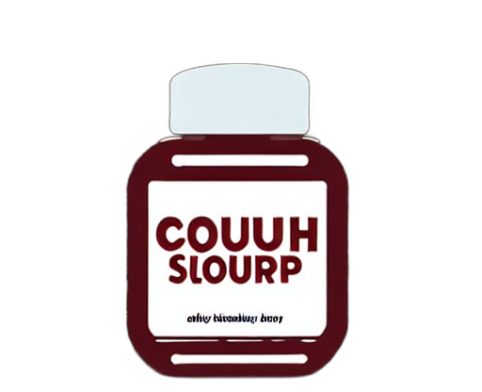
Control strategy
I had Stable Diffusion generate the imagery for the box fronts as the low quality was actually desired
Both positive and negative prompts were used to drive towards 2-D imagery
Images were created based on SKU visual dimensions to ensure a good fit
Images were processed to remove backgrounds and create transparent PNGs
Images were placed within hard-coded shelf_bounds to prevent clipping, and to enable a targeted 80% shelf fill rate
Notes:
Although a full store view could be generated, I found controlling the quality of the generated images to be imprecise and inconsistent enough to be practical

Slide 13
Tools and technologies
Generative AI: Stable Diffusion v1.5 (Inpainting & Text-to-Image).
Programming: Python (Pandas, Pillow, Diffusers, OpenCV).
Automation: gTTS (Google Text-to-Speech) for explanation of the changes to the Planogram.
Vector Graphics: XML-based SVG for layout orchestration.

Slide 14
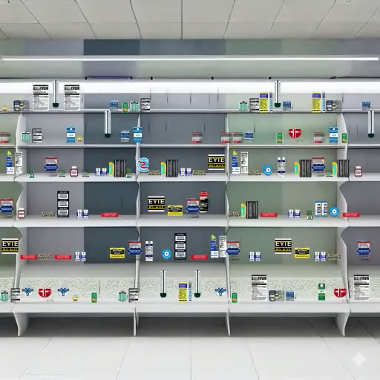
Demo Video

Slide 15
Video and GitHub URLs
GitHub: https://github.com/joelvinas/COMP-SCI_5542/tree/3272ebcc0ab6f1332e682f3a85e9787d82718b1b/Quiz%201
YouTube Video: https://youtu.be/e_uipJM81MU

Slide 16
Evaluation
Initial (PNG-only): Frequent 3D distortion, items floating in ceiling, unreadable labels.
Improved (SVG-Hybrid): 100% placement accuracy, high asset consistency, transparent layering.
Prompt Alignment: Metadata (Width/Height) now directly controls the visual canvas size.
Final: Multimodal integration (Audio + Animation) provides a functional retail demo.

Slide 17
Findings and insights
Observation: SD 1.5 has a strong 3D bias; aspect ratio forcing is more effective than keywords alone (even with strong negative prompting).
Determinism vs. Diversity: SVGs provide the necessary 'guardrails' for professional retail use. This also enables new SKUs to be created (with imagery) allowing fine control at scale
Multimodal Value: Adding audio briefings significantly increases stakeholder engagement with the AI tool.

Slide 18
Limitations & AI Disclosure
Limitations: Text legibility on SKU labels remains low; complex SKU placement mapping and reflection mapping is missing.
AI Tool Disclosure: Used Google Gemini/Google Antigravity for brainstorming, graphic design, code debugging and presentation structure.
Assisted Tasks: Prompt engineering, SVG animation logic, and data generation were AI-assisted.

